Slide 1
Database Management Systems SE 3309a
Lecture #13
Relational Algebra
Dr. Miriam Capretz
The University of Western Ontario
10/22/2014
Dr. Miriam Capretz SE3309a DBMS
‹#›
Notes:
‹#›

Slide 2
Relational Algebra
a (high level) procedural language:
it can be used to tell the DBMS how to build a new relation from one or more relations in the database
It has been used as the basis for higher-level Data Manipulation Languages (DMLs) for relational databases
10/22/2014
Dr. Miriam Capretz SE3309a DBMS
‹#›
Notes:
‹#›

Slide 3
Relational Algebra
Relational algebra operations work on one or more relations to define another relation without changing the original relations.
Both operands and results are relations, so output from one operation can become input to another operation.
Allows expressions to be nested, just as in arithmetic operations.
10/22/2014
Dr. Miriam Capretz SE3309a DBMS
‹#›
Notes:
‹#›

Slide 4
Relational Algebra
Five fundamental operations perform most of the data retrieval operations:
Selection
Projection
Cartesian product
Union
Set difference
These perform most of the data retrieval operations needed.
10/22/2014
Dr. Miriam Capretz SE3309a DBMS
‹#›
Notes:
‹#›

Slide 5

Relational Algebra
rich enough language to express enough useful things
σ SELECT
π PROJECT
X CARTESIAN PRODUCT FUNDAMENTAL
U UNION BINARY
– SET-DIFFERENCE
∩ SET-INTERSECTION
_{θ} THETA-JOIN CAN BE DEFINED
NATURAL JOIN IN TERMS OF
÷ DIVISION or QUOTIENT FUNDAMENTAL OPERATIONS
UNARY
10/22/2014
Dr. Miriam Capretz SE3309a DBMS
‹#›
Notes:
‹#›

Slide 6
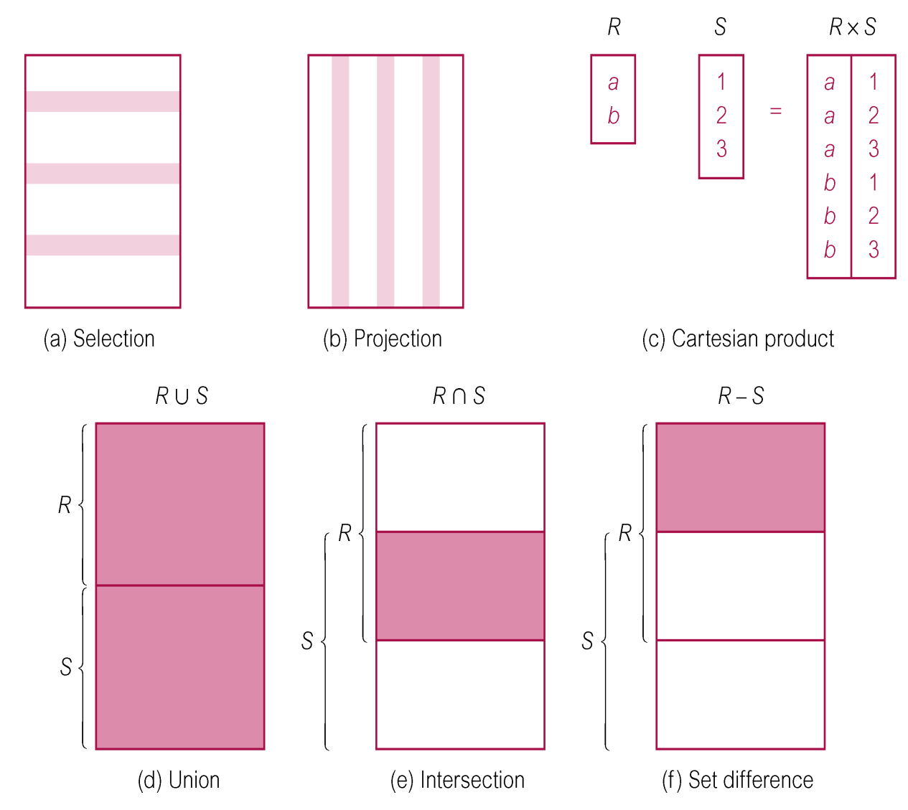
Relational Algebra Operations
10/22/2014
Dr. Miriam Capretz SE3309a DBMS
‹#›
Notes:
‹#›

Slide 7
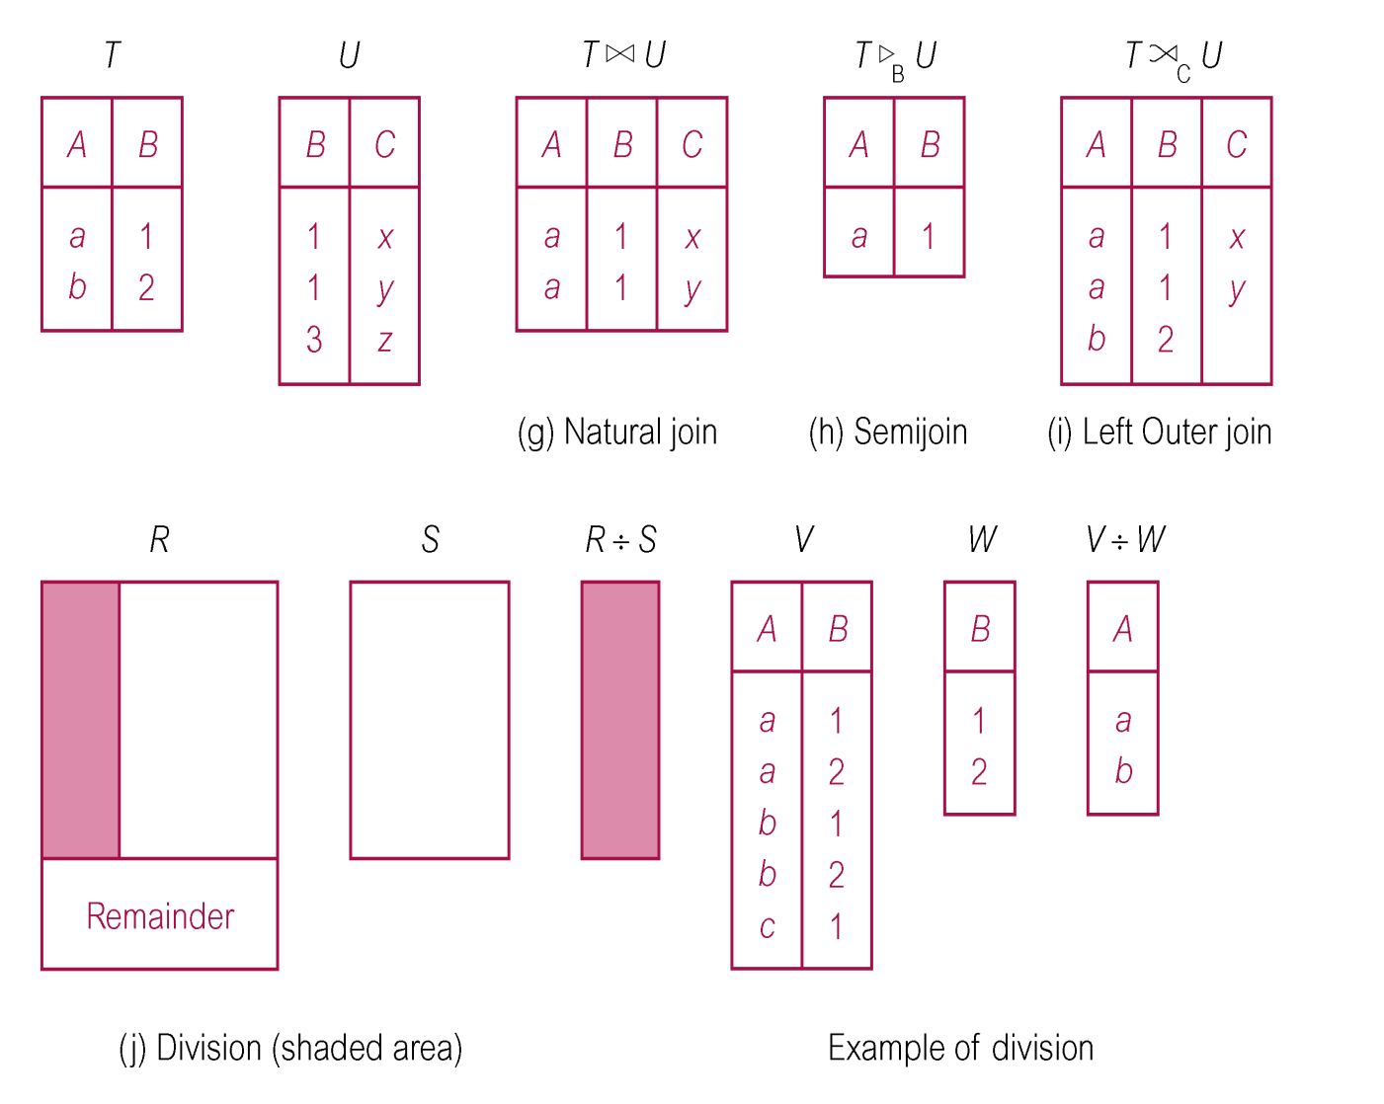
Relational Algebra Operations
10/22/2014
Dr. Miriam Capretz SE3309a DBMS
‹#›
Notes:
‹#›

Slide 8
Selection
σ_{predicate}(R) – the selection operation works on a single relation R and defines a relation that contains only those tuples of R that satisfies the specified condition (predicate)
10/22/2014
Dr. Miriam Capretz SE3309a DBMS
‹#›
Notes:
‹#›

Slide 9
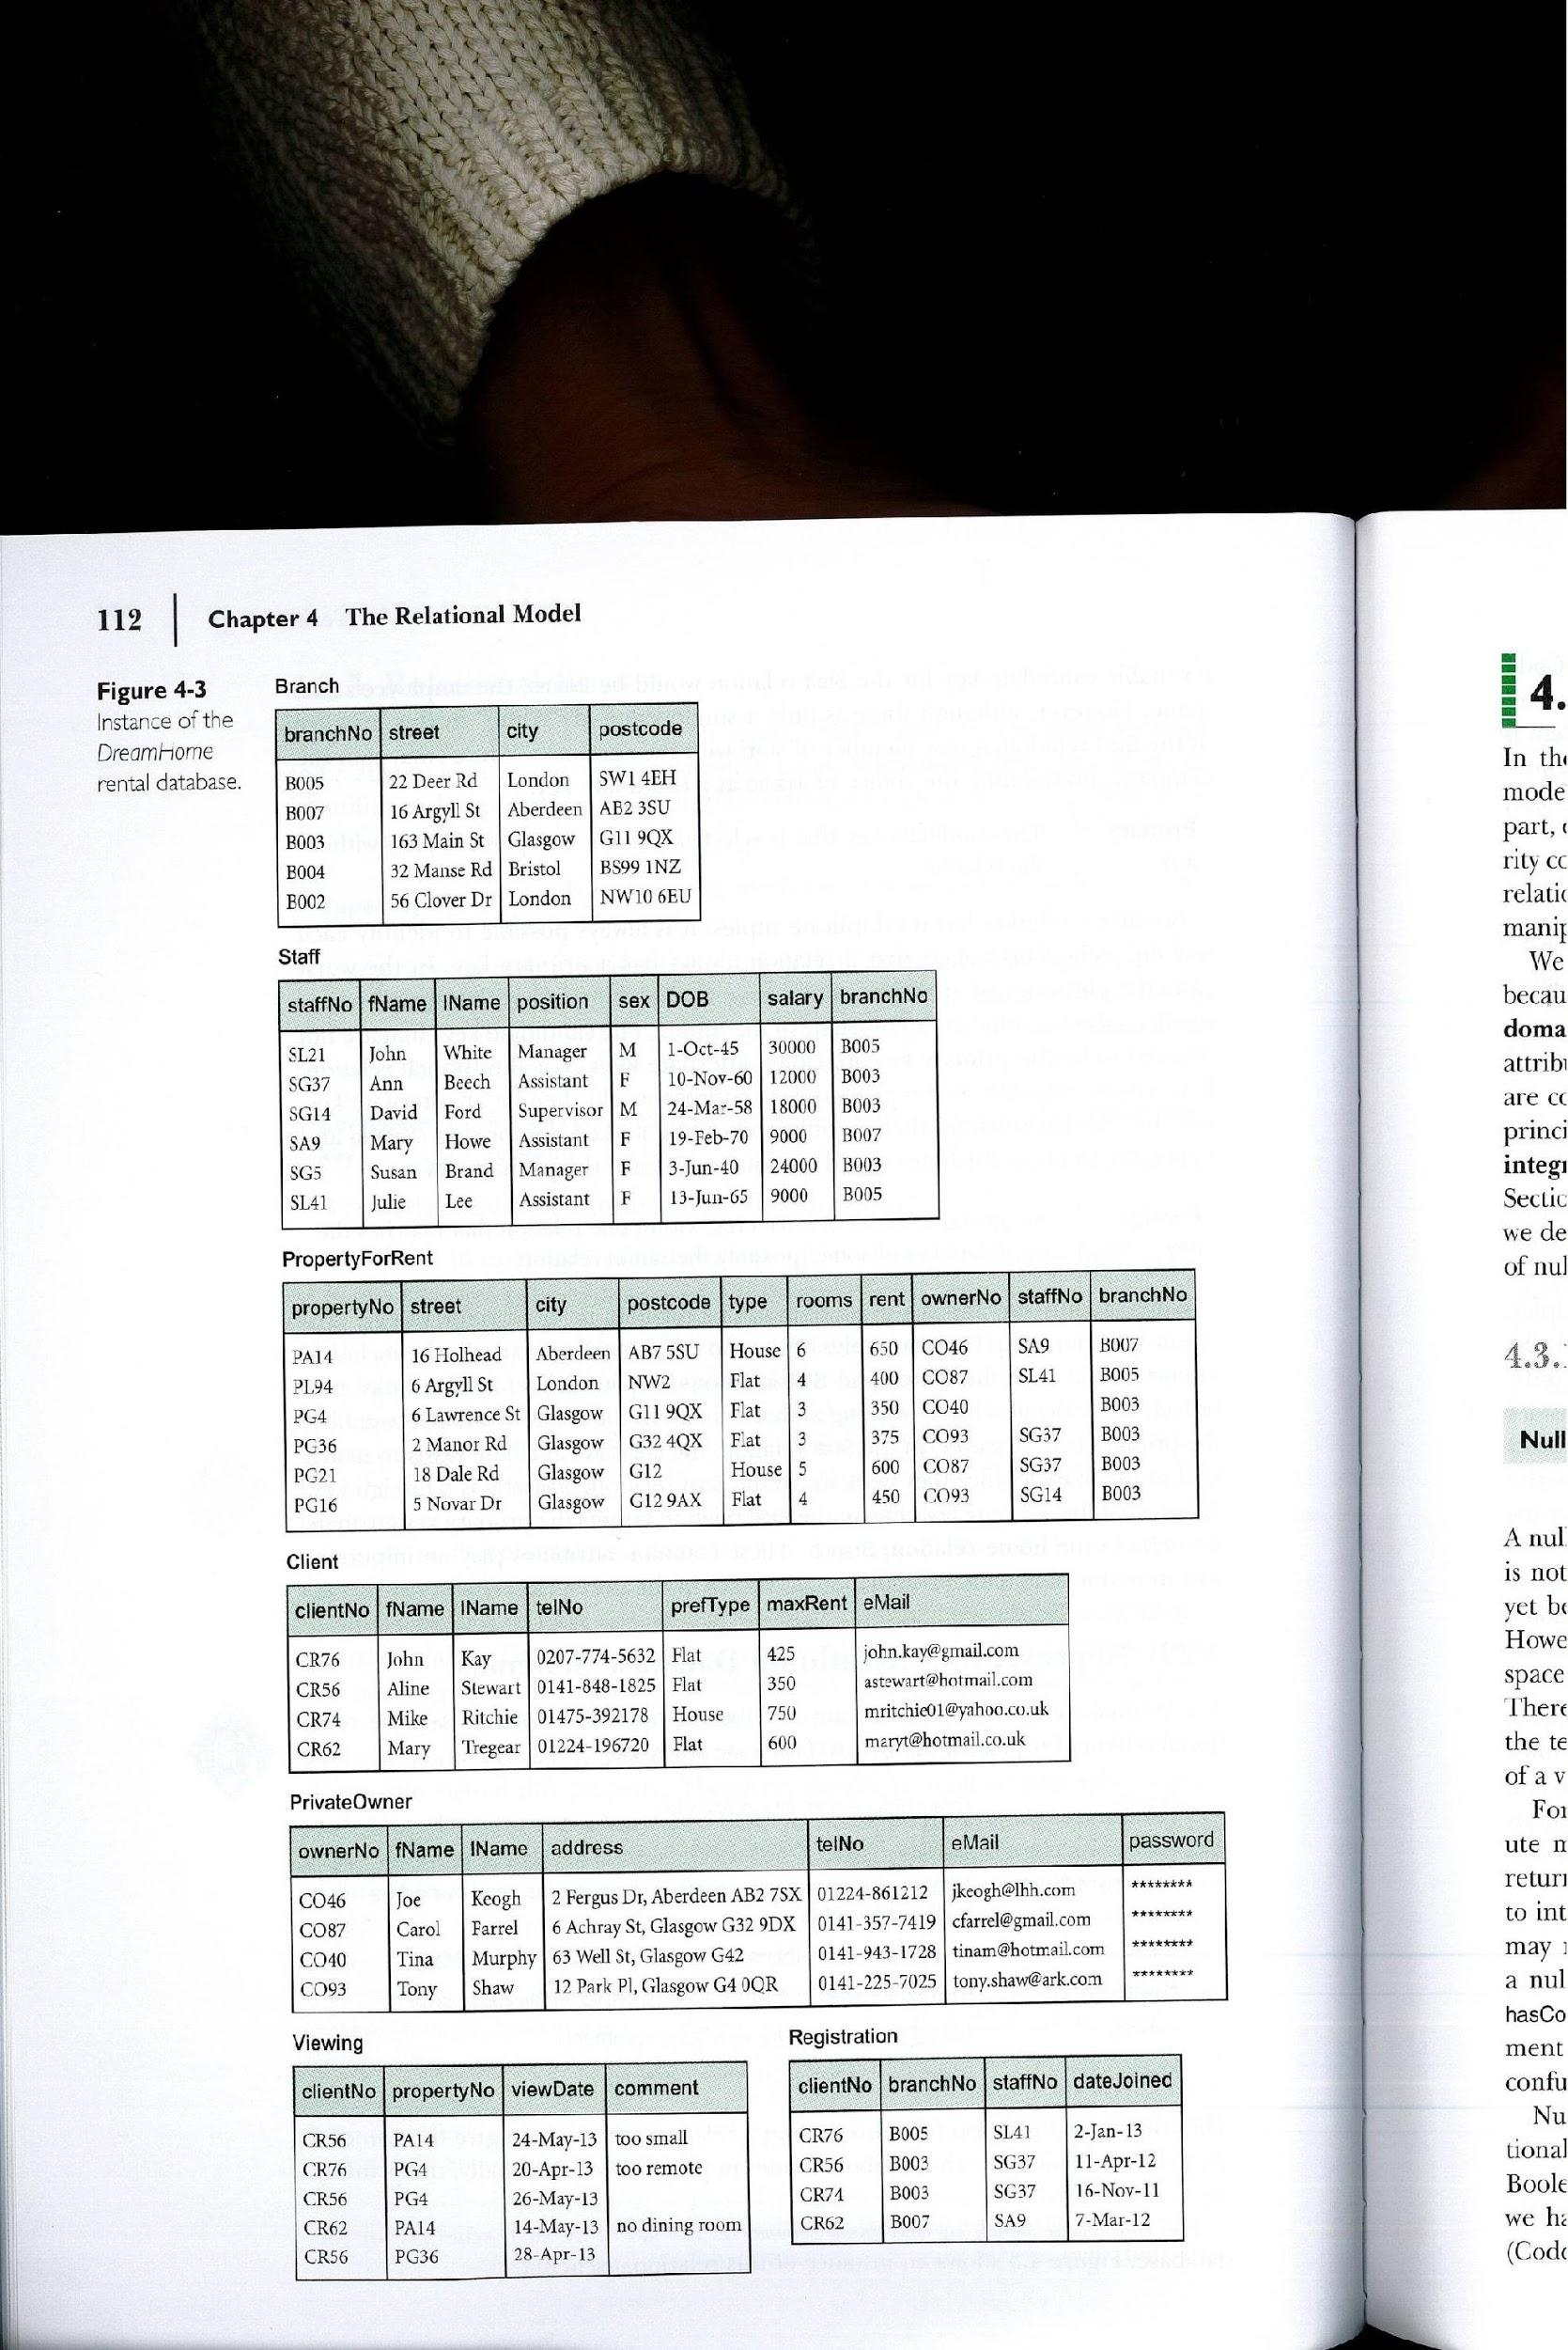
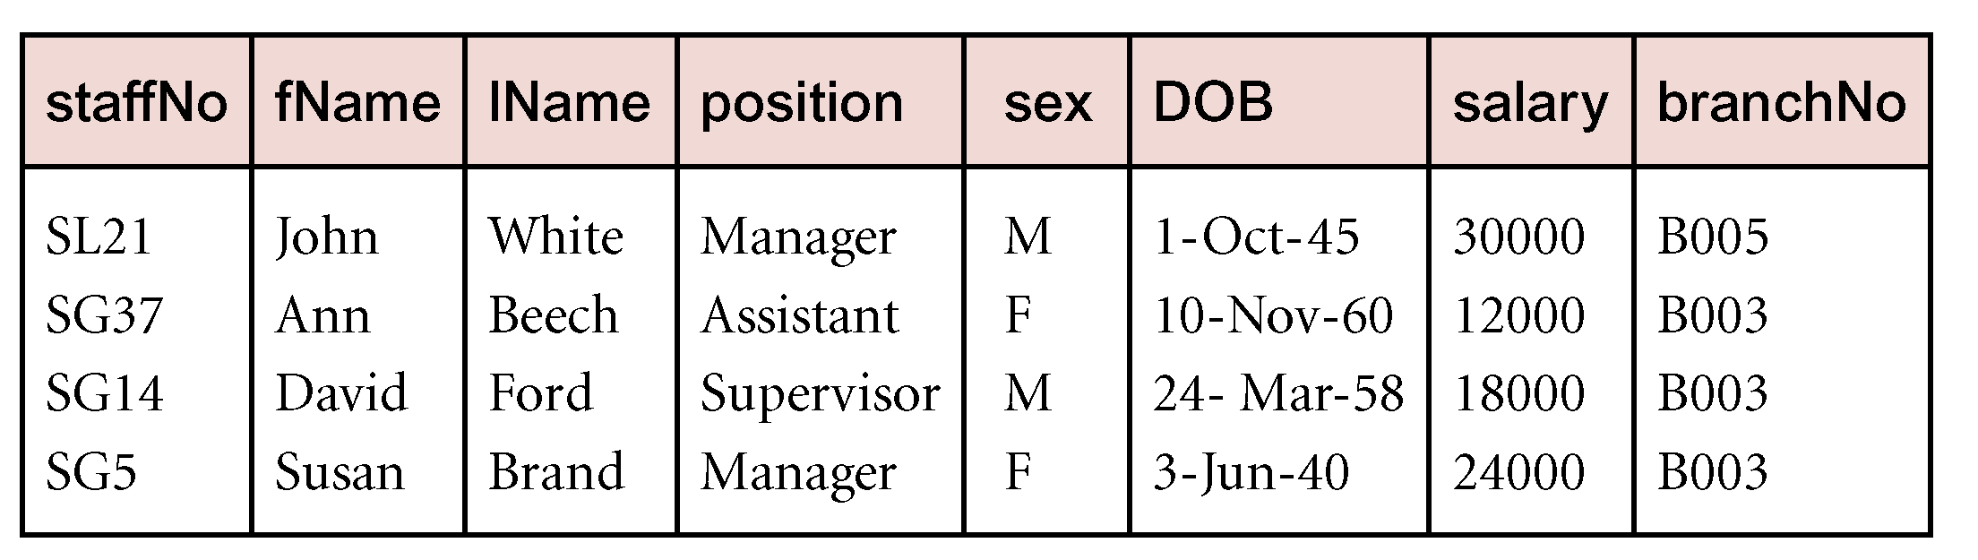
Selection
σ_{salary >10000}(Staff)
The input relation is Staff and
the predicate is salary >10000
More complex predicates can be generated using the logical operators ∼ (NOT) ∧(AND) ∨ (OR)
Selecting salary > 10000 from Staff relation
10/22/2014
Dr. Miriam Capretz SE3309a DBMS
‹#›
Notes:
‹#›

Slide 10
Projection
π _{a1,…an}(R) – the projection operation works on a single relation R and defines a relation that contains a vertical subset of R, extracting the values of specified attributes and eliminating duplicates
10/22/2014
Dr. Miriam Capretz SE3309a DBMS
‹#›
Notes:
‹#›

Slide 11
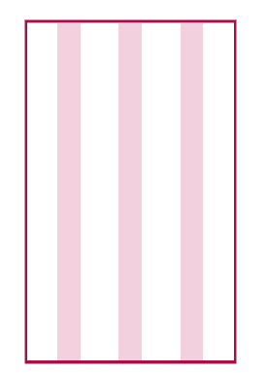
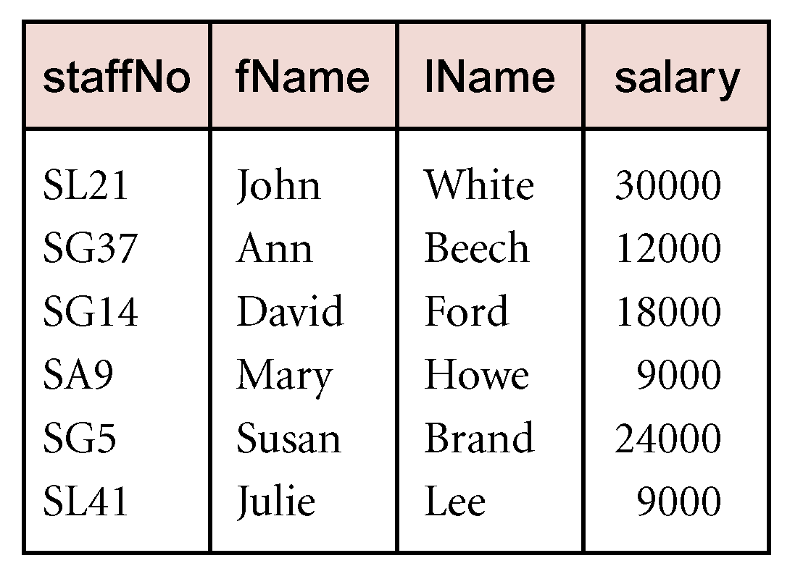
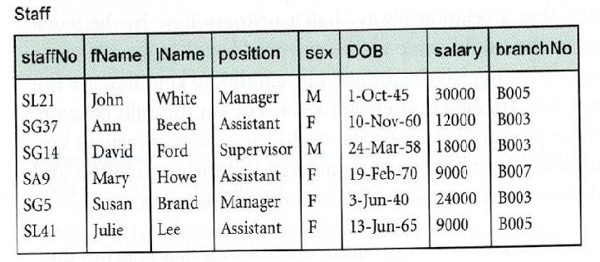
Projection
π _{staffNo,fName,lName,salary}(Staff)
Projecting the staff relation over the staffNo,fName,lName, and salary attributes
10/22/2014
Dr. Miriam Capretz SE3309a DBMS
‹#›
Notes:
‹#›

Slide 12
Union
(R ∪ S) – The union of two relations R and S defines a relation that contains all the tuples of R, or S, or both R and S, duplicate tuples being eliminated. R and S must be union compatible
Projection may be used to make
two relations union-compatible
10/22/2014
Dr. Miriam Capretz SE3309a DBMS
‹#›
Notes:
‹#›

Slide 13


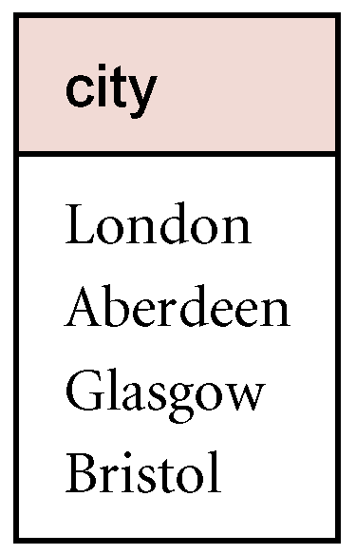
Union
List all cities where there is either a branch office or a property for rent
π_{City(} (Branch) ∪ π_{City(} (PropertyForRent)
To produce union-compatible relations, we first use the projection operation to project the branch and propertyForRent relations over the attribute city, eliminating duplicates when necessary
10/22/2014
Dr. Miriam Capretz SE3309a DBMS
‹#›
Notes:
‹#›

Slide 14
Set Difference
R – S the set difference operation defines a relation consisting of the tuples that are in relation R, but not in S, R and S must be union-compatible
10/22/2014
Dr. Miriam Capretz SE3309a DBMS
‹#›
Notes:
‹#›

Slide 15

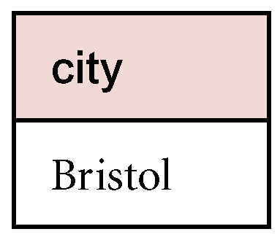
Set Difference
List all cities where there is a branch office but no properties for rent
π_{City(} (Branch) − π_{City(} (PropertyForRent)
We produce union-compatible relations by projecting the branch and propertyForRent relations over the attribute city. We then use the set difference operation to combine these new relations.
10/22/2014
Dr. Miriam Capretz SE3309a DBMS
‹#›
Notes:
‹#›

Slide 16
Intersection
(R ∩ S) the intersection operation defines a relation consisting of the set of all tuples that are in both R and S. R and S must be union-compatible
10/22/2014
Dr. Miriam Capretz SE3309a DBMS
‹#›
Notes:
‹#›

Slide 17

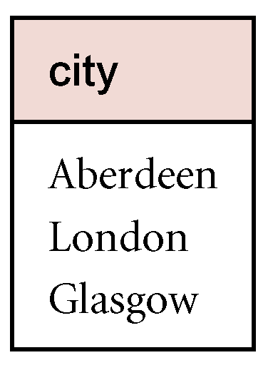
Intersection
List all cities where there is both a branch office and at least one properties for rent
π_{City(} (Branch) ∩ π_{City(} (PropertyForRent)
We produce union-compatible relations by projecting the branch and propertyForRent relations over the attribute city. We then use the intersection operation to combine these new relations.
10/22/2014
Dr. Miriam Capretz SE3309a DBMS
‹#›
Notes:
‹#›

Slide 18
Cartesian Product
R X S the Cartesian product operation defines a relation that is the concatenation of every tuple of relation R with every tuple of relation S
10/22/2014
Dr. Miriam Capretz SE3309a DBMS
‹#›
Notes:
‹#›

Slide 19

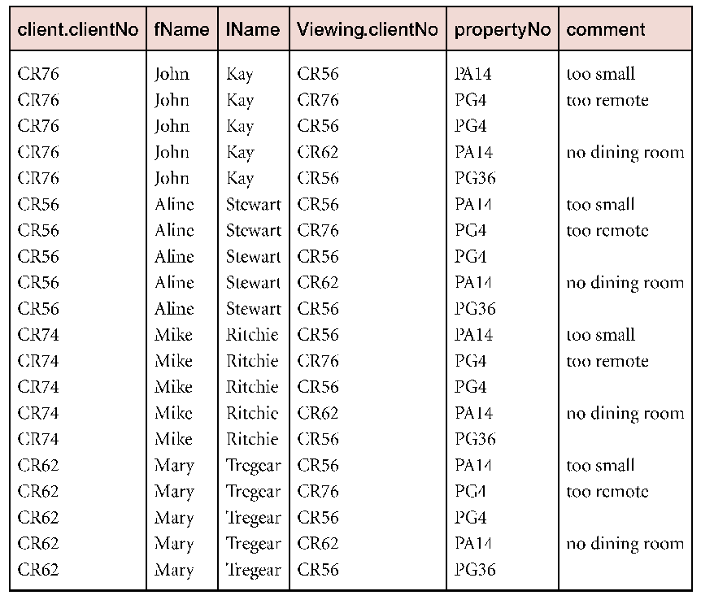
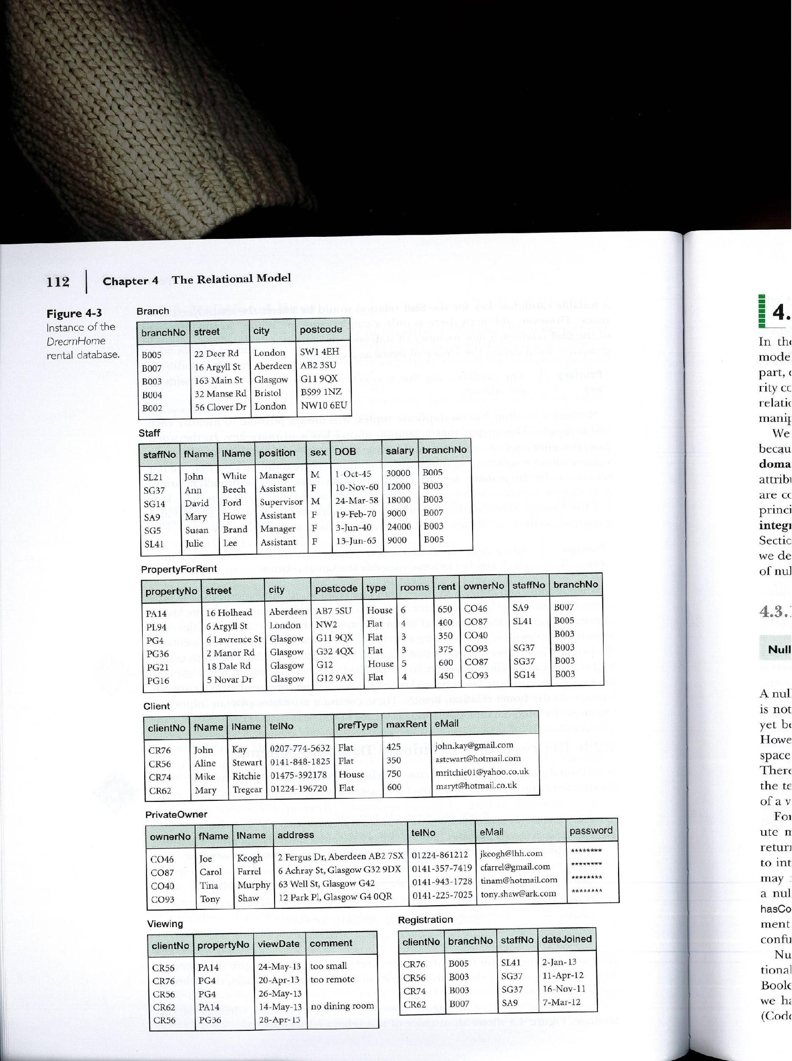
Cartesian Product
List the names and comments of all clients who have viewed a property for rent
(π_{ClientNo,fName,lName} (Client)) X (π_{ClientNo,propertyNo,comment}(Viewing))
Cartesian product of reduced client and Viewing relations
10/22/2014
Dr. Miriam Capretz SE3309a DBMS
‹#›
Notes:
‹#›

Slide 20
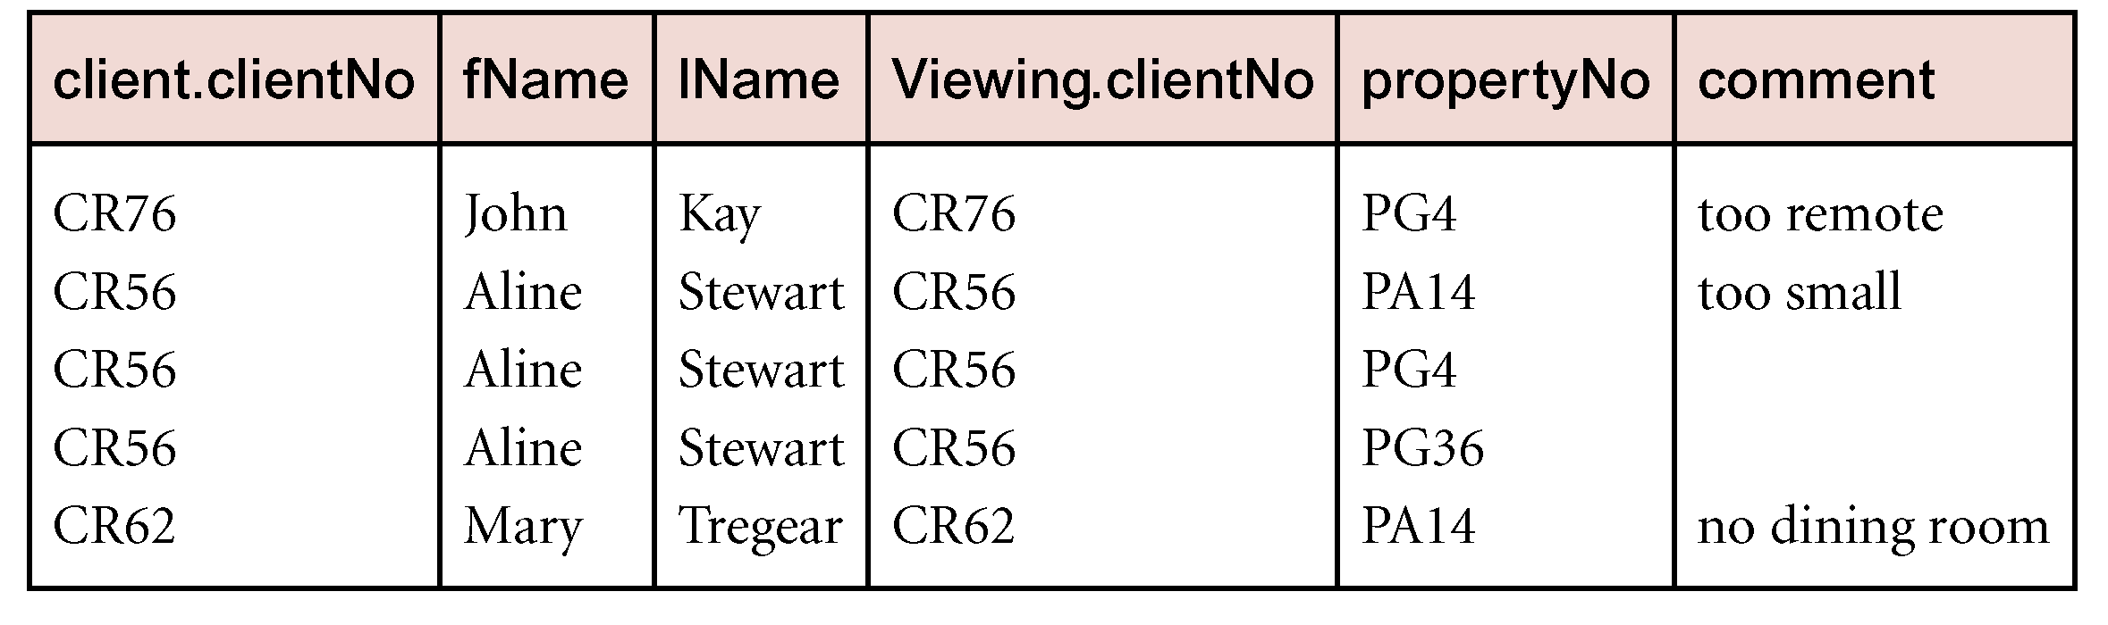
Cartesian Product
To obtain the required list, we need to carry out a selection operation on this relation to extract those tuples where client.clientNo = Viewing.clientNo.
σclient.clientNo=viewing.clientNo((π_{ClientNo,fName,lName} (Client)) X (π_{ClientNo,propertyNo,comment}(Viewing)) )
Cartesian product and Selection can be reduced to a single operation called a Join.
Restricted Cartesian Product of reduced client and viewing relations
10/22/2014
Dr. Miriam Capretz SE3309a DBMS
‹#›
Notes:
‹#›

Slide 21
Join Operations
Join is a derivative of Cartesian product.
Equivalent to performing a Selection, using join predicate as selection formula, over Cartesian product of the two operand relations.
One of the most difficult operations to implement efficiently in an RDBMS and one reason why RDBMSs have intrinsic performance problems.
10/22/2014
Dr. Miriam Capretz SE3309a DBMS
‹#›
Notes:
‹#›

Slide 22
Join Operations
Various forms of join operation:
Theta join
Equijoin (a particular type of Theta join)
Natural join
Outer join
Semijoin
10/22/2014
Dr. Miriam Capretz SE3309a DBMS
‹#›
Notes:
‹#›

Slide 23

Theta-Join (θ-join)
R = R₁ _{C} R₂ is equivalent to R = σ_{C}(R₁ × R₂)
As with Cartesian product, the degree of a Theta join is the sum of the degrees of the operand relations R₁ and R₂.
If predicate C contains only equality (=), the term Equijoin is used.
10/22/2014
Dr. Miriam Capretz SE3309a DBMS
‹#›
Notes:
‹#›

Slide 24
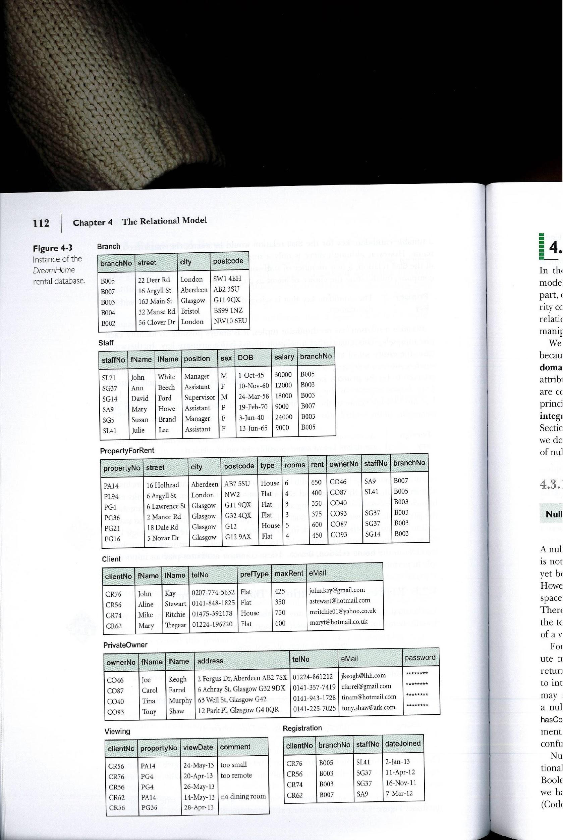

Example - Equijoin
List the names and comments of all clients who have viewed a property for rent
(π_{ClientNo,fName,lName} (Client)) Client.clientNo=Viewing.clientNo (π_{ClientNo,propertyNo,comment}(Viewing))
10/22/2014
Dr. Miriam Capretz SE3309a DBMS
‹#›
Notes:
‹#›

Slide 25

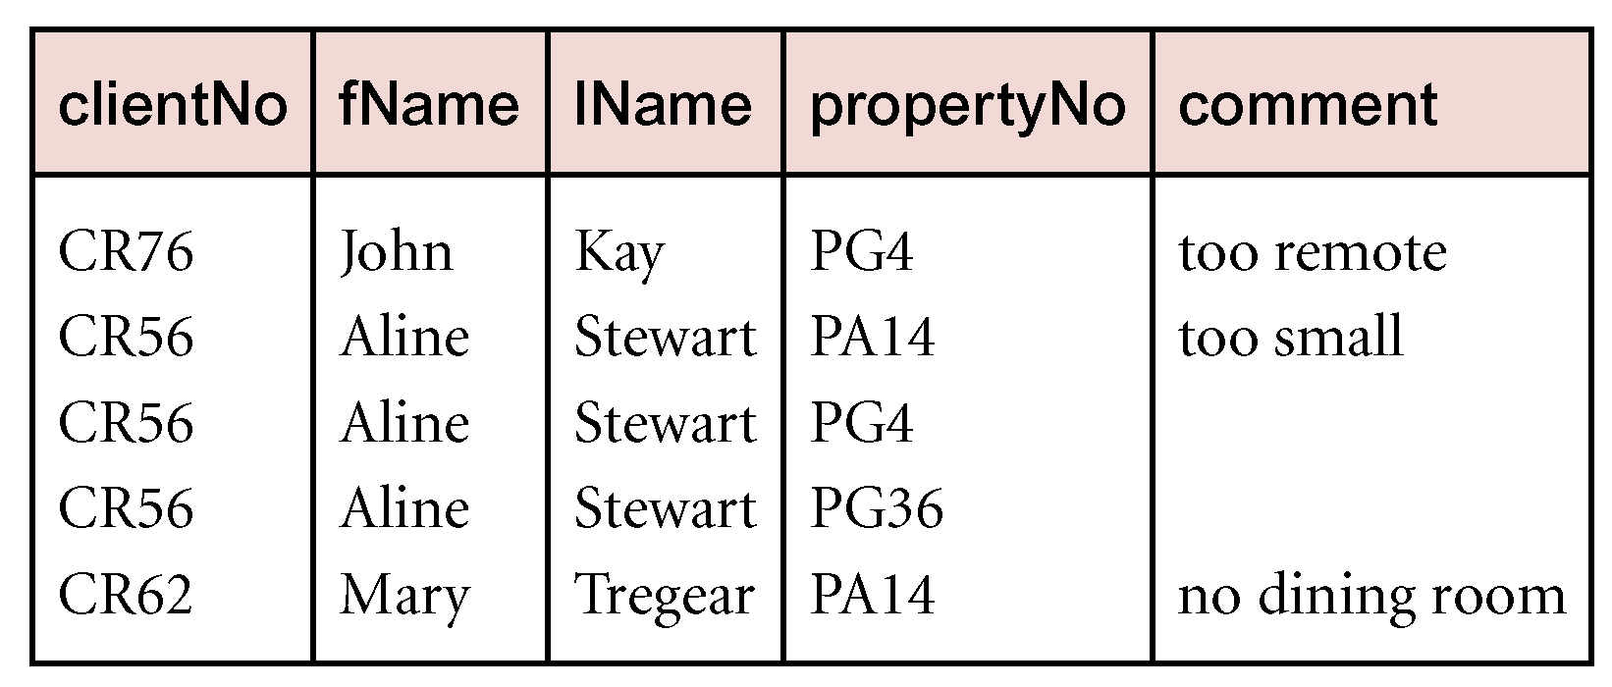
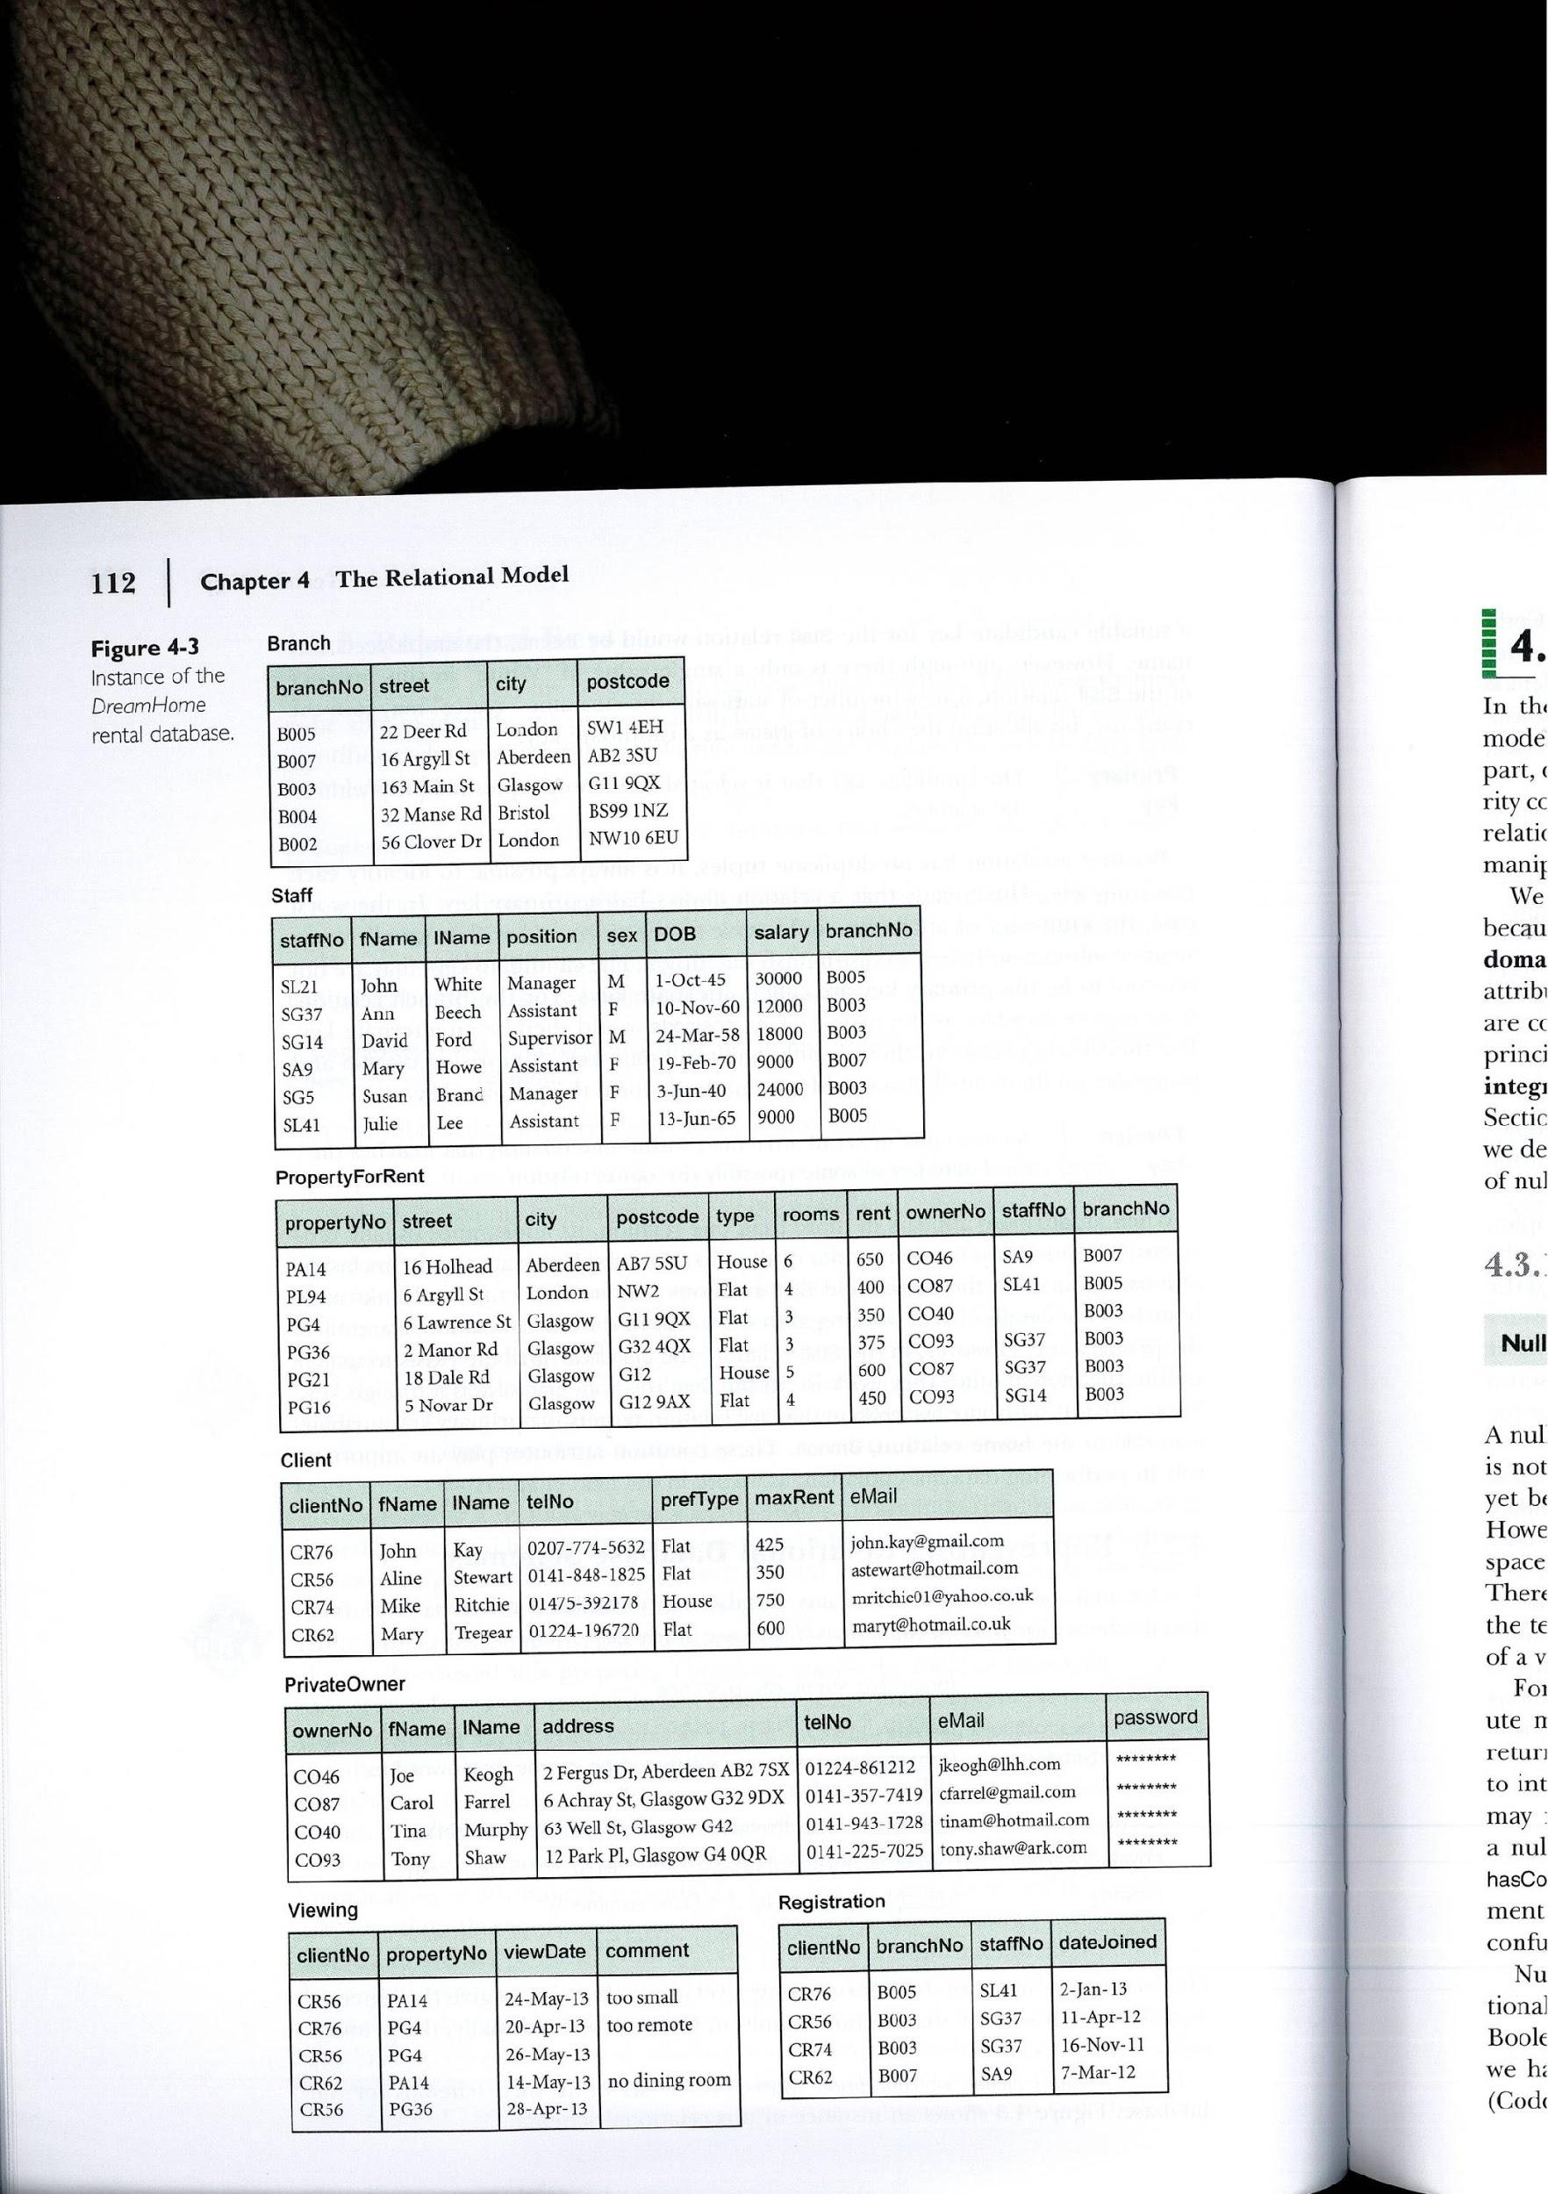
Natural Join
R S An Equijoin of the two relations R and S over all common attributes x. One occurrence of each common attribute is eliminated from the result.
(π_{ClientNo,fName,lName} (Client)) (π_{ClientNo,propertyNo,comment}(Viewing))
List the names and comments of all clients who have viewed a property for rent
Natural join of restricted client and viewing relations
10/22/2014
Dr. Miriam Capretz SE3309a DBMS
‹#›
Notes:
‹#›

Slide 26
Outer join
To display rows in the result that do not have matching values in the join column, use Outer join.
R S
(Left) outer join is join in which tuples from R that do not have matching values in common columns of S are also included in result relation.
10/22/2014
Dr. Miriam Capretz SE3309a DBMS
‹#›
Notes:
‹#›

Slide 27
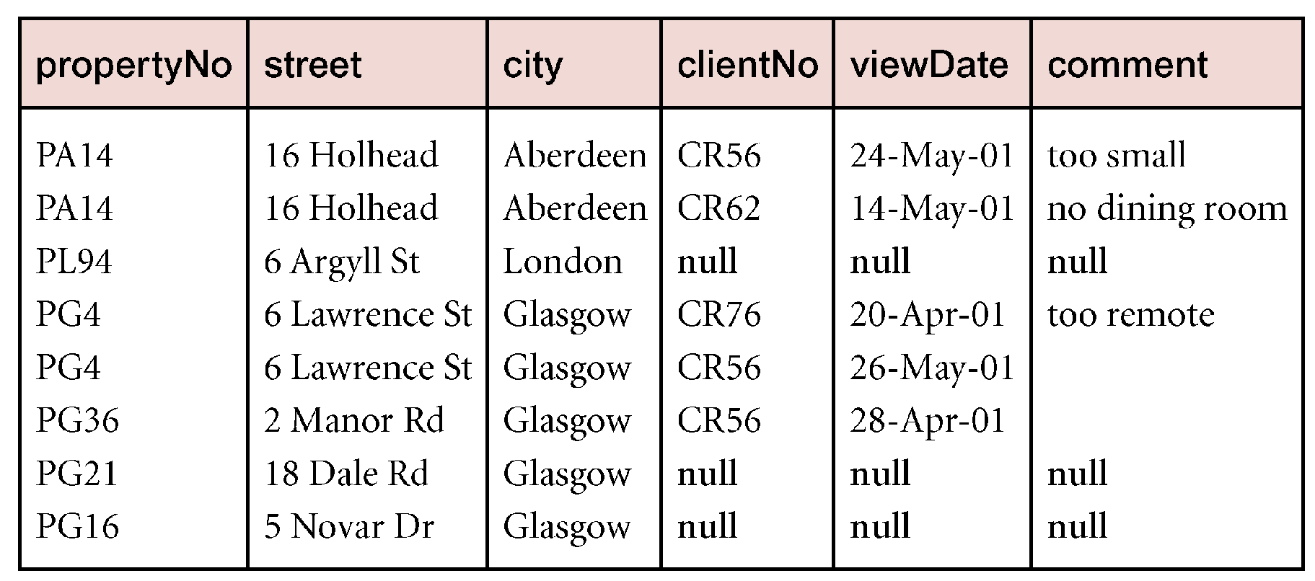
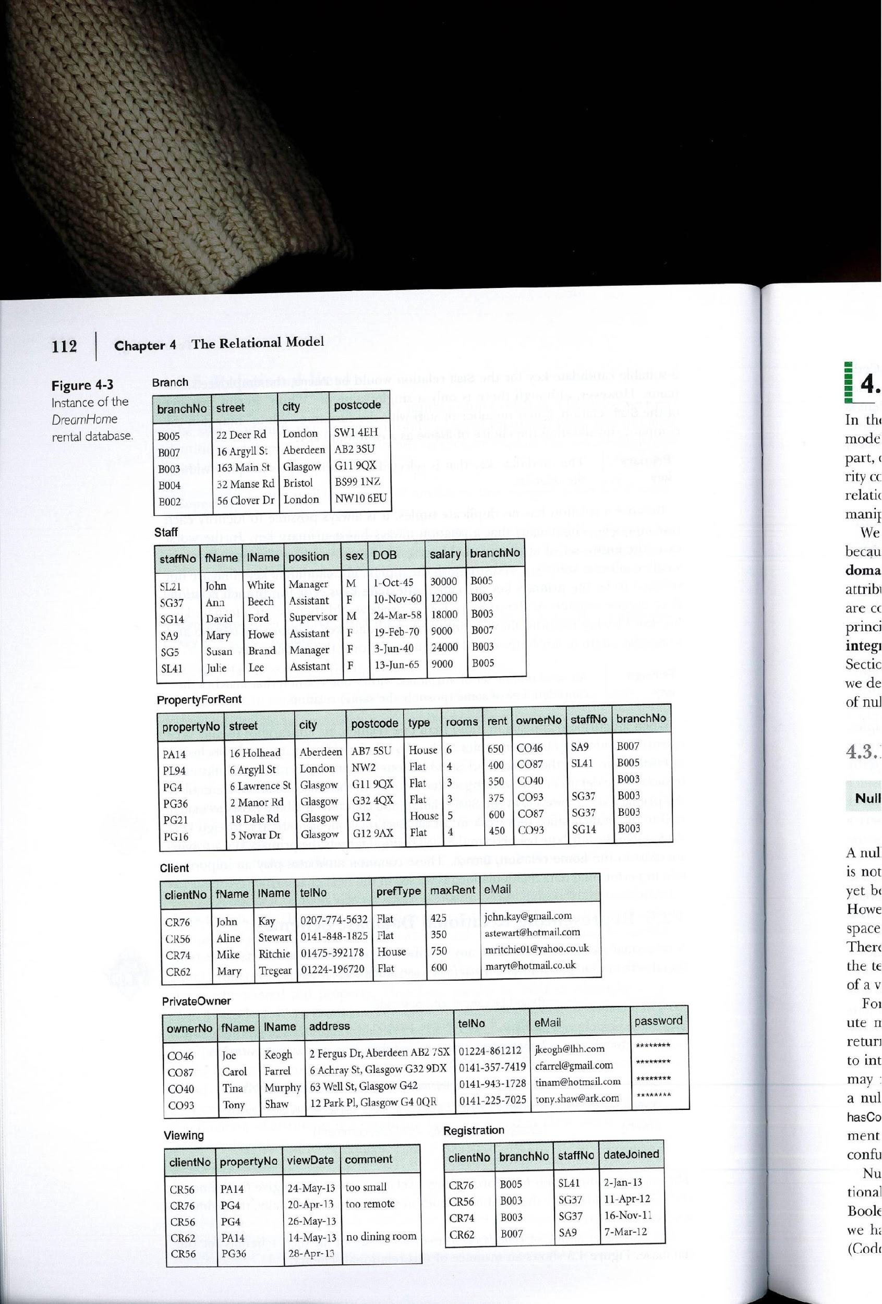
Example - Left Outer join
Produce a status report on property viewings.
Π_{propertyNo, street, city}(PropertyForRent) Viewing
10/22/2014
Dr. Miriam Capretz SE3309a DBMS
‹#›
Notes:
‹#›

Slide 28
Semijoin
R _{F} S
Defines a relation that contains the tuples of R that participate in the join of R with S satisfying the predicate F
Can rewrite Semijoin using Projection and Join:
R _{F} S = Π_{A}(R _{F} S)
10/22/2014
Dr. Miriam Capretz SE3309a DBMS
‹#›
Notes:
‹#›

Slide 29
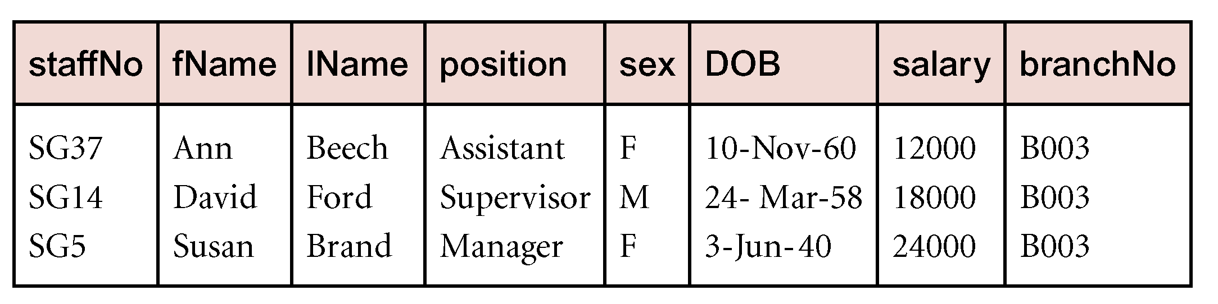
Example - Semijoin
List complete details of all staff who work at the branch in Glasgow.
Staff Staff.branchNo = Branch.branchNo (σ_{city = ‘Glasgow’} (Branch))
10/22/2014
Dr. Miriam Capretz SE3309a DBMS
‹#›
Notes:
‹#›

Slide 30
Division
R ÷ S
Defines a relation over the attributes C that consists of set of tuples from R that match combination of every tuple in S.
10/22/2014
Dr. Miriam Capretz SE3309a DBMS
‹#›
Notes:
‹#›

Slide 31
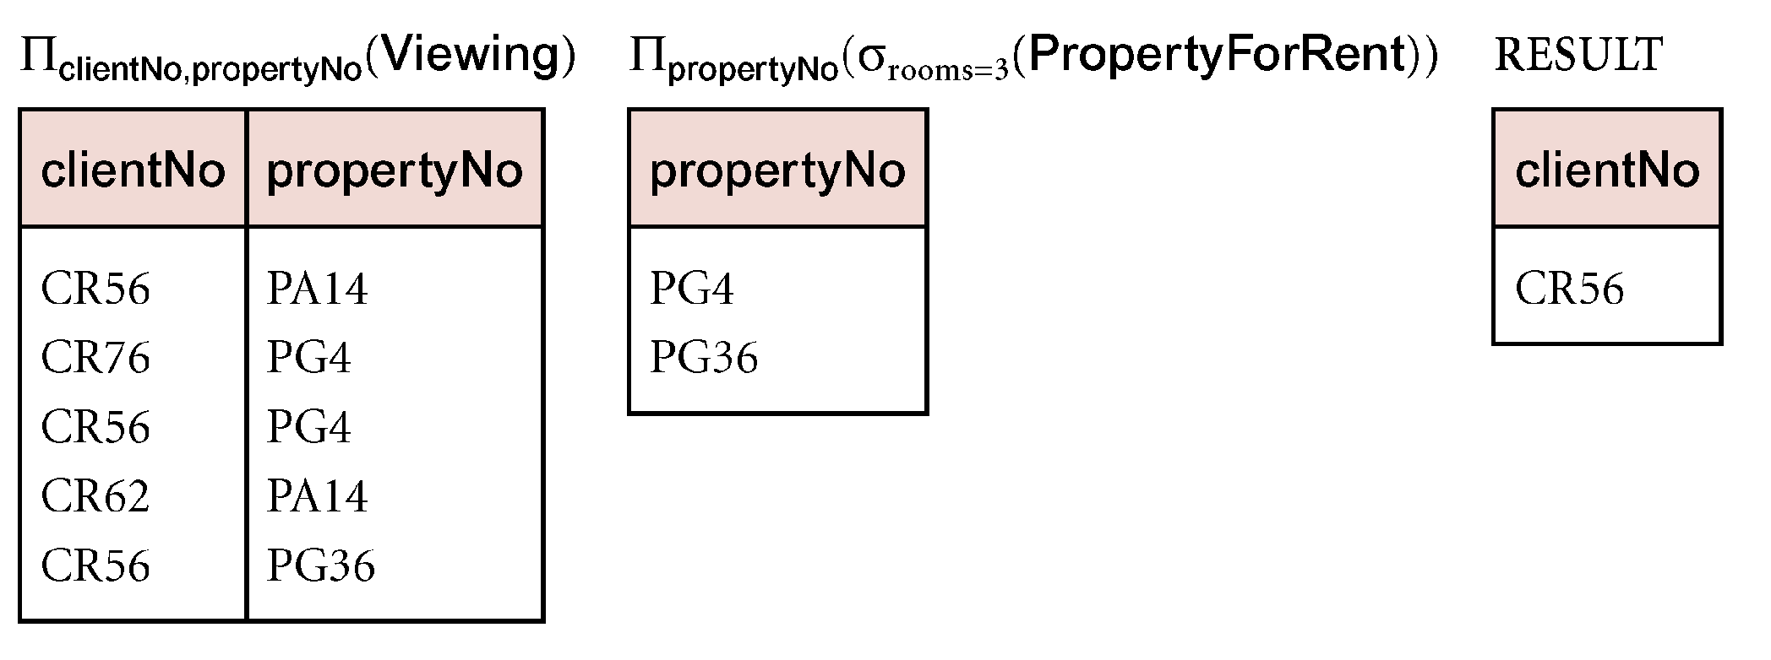
Example - Division
Identify all clients who have viewed all properties with three rooms.
(Π_{clientNo, propertyNo}(Viewing)) ÷ (Π_{propertyNo}(σ_{rooms = 3} (PropertyForRent)))
10/22/2014
Dr. Miriam Capretz SE3309a DBMS
‹#›
Notes:
‹#›

Slide 32
Operator Precedence
The normal way to group operators is:
Unary operators σ and π have highest precedence.
Next highest are the “multiplicative” operators, , _{C} , and ×.
Lowest are the “additive” operators, ∪, ∩, and —.
But there is no universal agreement, so we always put parentheses around the argument of a unary operator, and it is a good idea to group all binary operators with parentheses enclosing their arguments.
Example
Group R ∪ σS T as R ∪ (σ(S ) T ).
10/22/2014
Dr. Miriam Capretz SE3309a DBMS
‹#›
Notes:
‹#›

Slide 33
Each Expression Needs a Schema
If ∪, ∩, — are applied, the attributes of both relations have to be the same
Projection: use the attributes listed in the projection.
Selection: no change in the list of attributes.
Product R × S: use attributes of R and S.
But if they share an attribute A, prefix it with the relation name, as R.A, S.A.
Theta-join: same as product.
Natural join: use attributes from each relation; common attributes are merged anyway.
10/22/2014
Dr. Miriam Capretz SE3309a DBMS
‹#›
Notes:
‹#›

